Slide 1

FACIAL EXPRESSION BASED MUSIC GENERATOR

Slide 2

A human face is able to convey many emotion without words. It is universal and natural.

Slide 3
OBJECTIVE:
Study the facial expression of the person and detect his probable emotion and provide a suitable environment based on the mood of the user.
Suitable environment provided can be given using lights, music and other interactive environments.

Slide 4
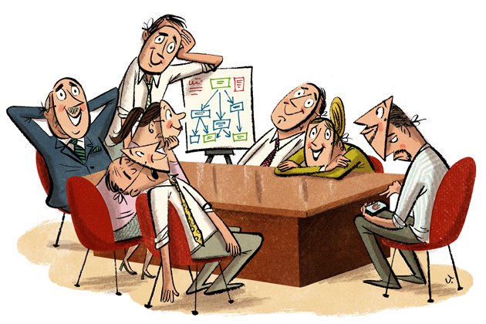
HOW IT ALL STARTED

Slide 5




Slide 6




Slide 7

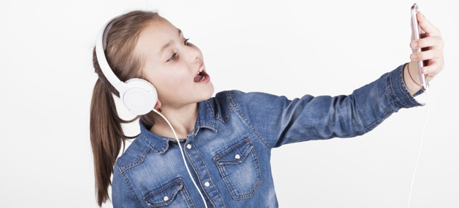
BUSINESS MODEL
The scenario we are discussing can be turned into a real life applications with a great business model.
1.The Application can be used in Smart home
2.It can be used in Smart cars.
3.It Can be an integrated as an application in smart speakers such as Amazon Alexa, Google Home.
4.It Can be a part of the assistants available on the smart phones.

Slide 8

MARKET ANALYSIS
1. Disney has been using this technology to determine how much audience enjoy its movies, by creating an AI-powered algorithm that can recognise complex facial expressions and even predict upcoming emotions.
2. Kellogg’s is another high-profile example. It uses the technology to review their ads for engagement before airing it.

Slide 9
MARKET ANALYSIS
3. Unilever, using HireVue’s AI-powered technology screens prospective candidates based on factors like body language and mood. In doing so, the company is able to find the person whose personality and characteristics are best suited to the job.
4. From detecting distracted drivers to monitoring levels of drowsiness, this type of data could be hugely invaluable for both brands and consumers, surely making it only a matter of time before it is integrated into vehicles.

Slide 10

INPUT

Slide 11

DATA PREPARATION FOR FACE RECOGNITION

Slide 12
DATA CONSOLIDATION: The dataset for the pixel values was obtained from the Kaggle Repository and the emotion label was obtained from Microsoft’s GitHub profile. Then both the datasets were consolidated.

Slide 13
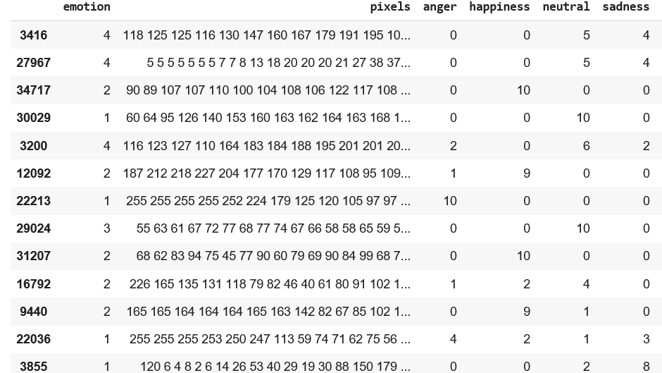
DATA SET FOR FACE RECOGNITION:

Slide 14
DATA CLEANING: After forming our own dataset, images with emotion other than our base emotions and with no faces at all were removed to reduce noise. DATA TRANSFORMATION: The data normalization technique used is, (X - X_mean) / (Standard Deviation)

Slide 15
DATA REDUCTION: Data was reduced to better fit our 4 emotion classification.

Slide 16
DATA PREPARATION FOR MUSIC GENERATION

Slide 17
DATA CONSOLIDATION: We collected different sound clips with lables as happy, sad, angry or neutral moods from different sources and then combined it.

Slide 18
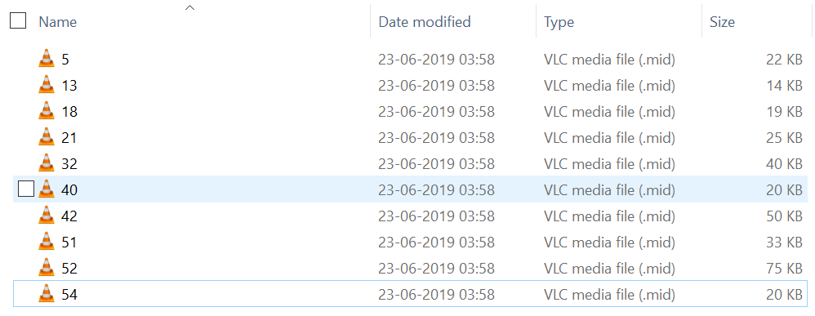

DATA SET FOR MUSIC GENERATION:

Slide 19
DATA CLEANING: The emotions for most songs were missing. So we hand labelled 1000 songs. DATA TRANSFORMATION: We created new dataset called notes for every sound file.

Slide 20
DATA REDUCTION: We removed the records that had a lot of mixed emotions, like songs having both happy and sad.

Slide 21
MODELLING

Slide 22
CONVOLUTION NEURAL NETWORKING

Slide 23






MODEL

Slide 24
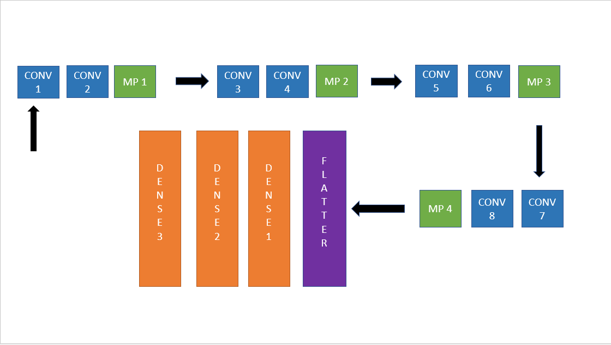
CNN MODEL

Slide 25
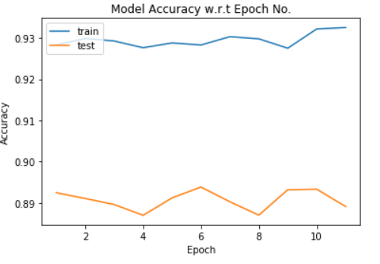
EPOCH VS ACCURACY

Slide 26
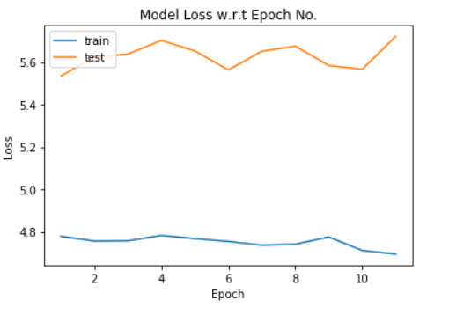
EPOCH VS LOSS

Slide 27
Demo

Slide 28
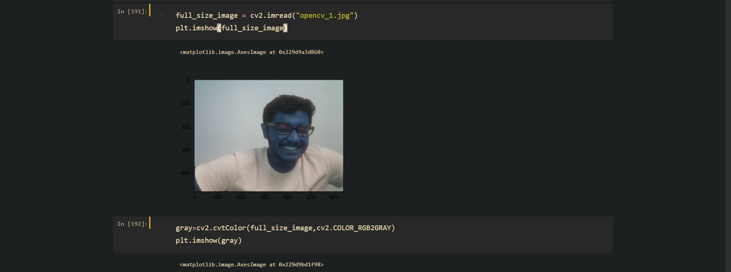
RECOGNITION OF FACIAL EXPRESSION:

Slide 29
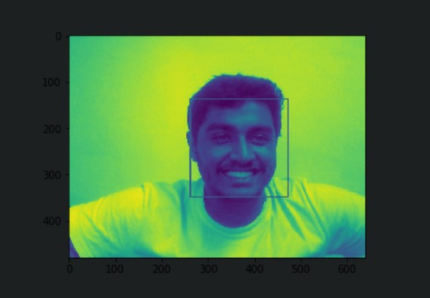
GREY SCALING

Slide 30
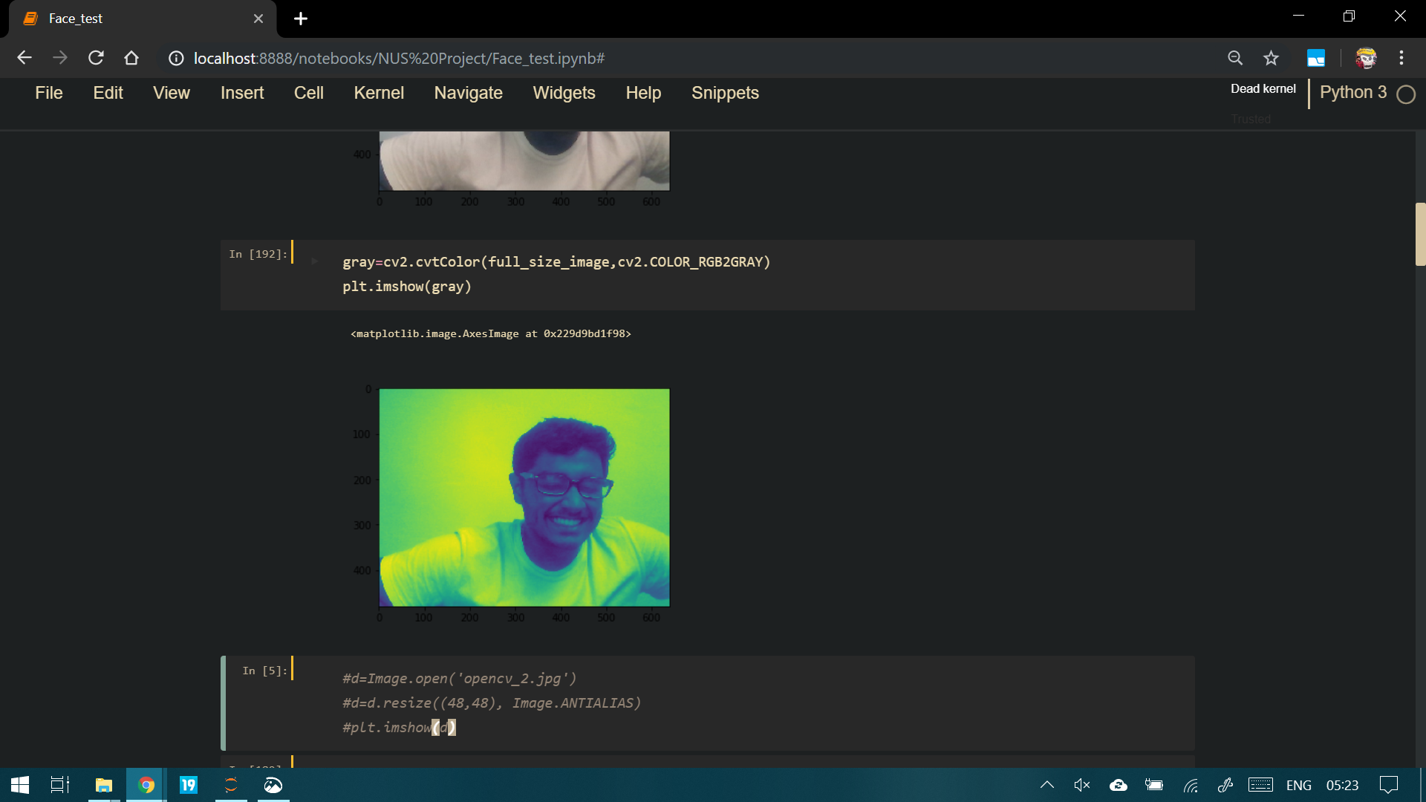

Slide 31
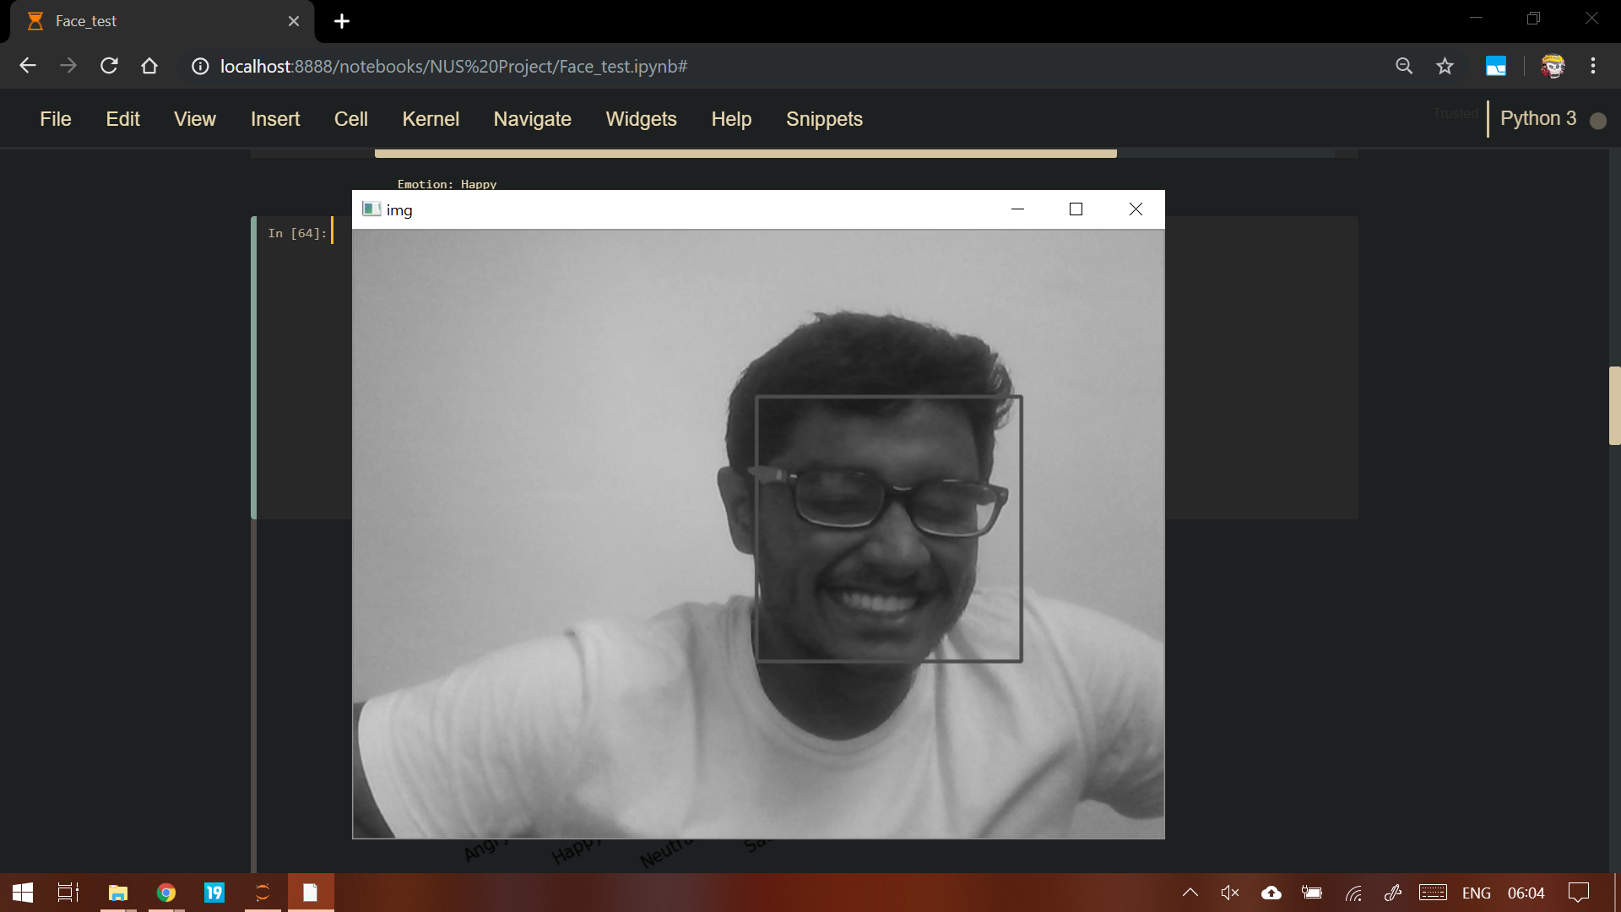

Slide 32
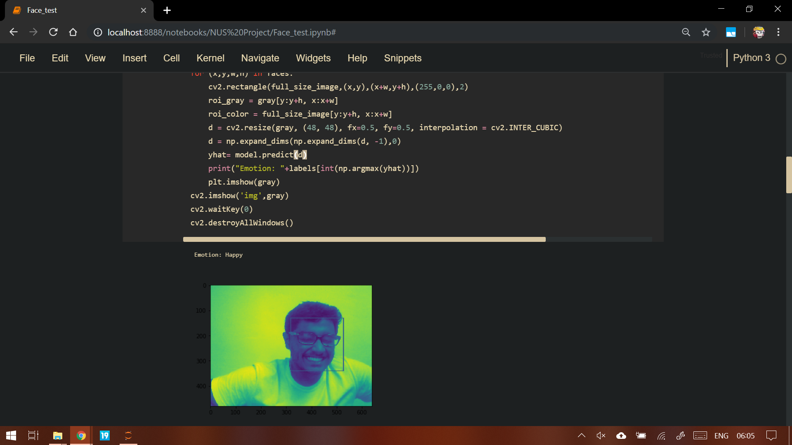
GREY SCALING

Slide 33
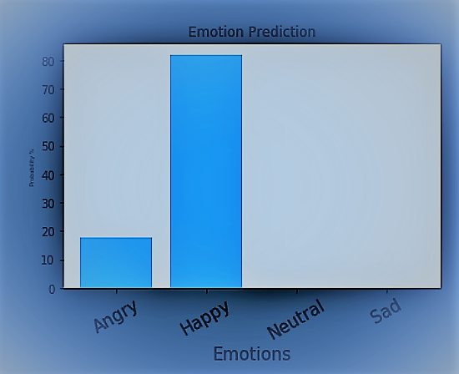

Slide 34
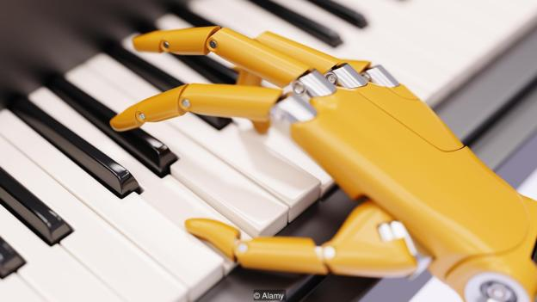
FUTURE DEVELOPMENT
Implementing our idea in smart homes for many more use cases for everyday user.
Recommending movies , video clips, articles, trivia etc. from various publishers based on the detected mood
Modelling the conversation itself based on the model.

Slide 35


REFERENCE:
https://github.com/microsoft/FERPlus
https://www.kaggle.com/c/challenges-in-representation-learning-facial-expression-recognition-challenge/data

Slide 36


THE TEAM
PRATYUSH AGARWAL
NAVDEEP BENIWAL
NAVEEN KUMAR
ASVATAMAN V
NAVEEN S
SHREYAS RENGA T R

